Slide 1
SWIFT
INTRODUÇÃO A LINGUAGEM DA MAÇÃ

Slide 2
Hello!
I Am Vinicius
I am here because I love to technologies for iOS.
You can contact me at
@ViniciusDeep

Slide 4
“
“Swift is like C”
“Swift is CLIKE”

Slide 5
THE BASICS
Constants and Variables
Types
Casting

Slide 6
THE BASICS
Constants and Variables
let maximumNumberOfLoginAttempts = 10
var currentLoginAttempt = 0

Slide 7
THE BASICS
Constants and Variables
Types
let maximumNumberOfLoginAttempts : Int
var currentLoginAttempt : Int
let π : Double = 3.1415
let nameOfUser : String = “Michael Douglas”
let haveCount = true

Slide 8
THE BASICS
Constants and Variables
Types
Casting
let three :Int = 3
let pointOneFourOneFiveNine = 0.14159
let pi = Double(three) + pointOneFourOneFiveNine

Slide 9
THE BASICS
Tuples
let http404Error = (404, "Not Found")
let http200Status = (statusCode: 200, description: "OK")

Slide 10
THE BASICS
Strings are Value Types
let string1 = "hello"
let string2 = " there"
var welcome = string1 + string2
let multiplier = 3
let message = "\(multiplier) times 2.5 is \(Double(multiplier) * 2.5)"

Slide 11
OPTIONALS?
let possibleNumber = "123"
let convertedNumber = Int(possibleNumber)
nil?
var serverResponseCode: Int? = 404
// serverResponseCode contains an actual Int value of 404
serverResponseCode = nil
// serverResponseCode now contains no value

Slide 12

Hands On!

Slide 13
IF STATEMENTS
let name = "world"
if name == "world" {
print("hello, world")
} else {
print("I'm sorry \(name), but I don't recognize you")
}
// Prints "hello, world", because name is indeed equal to "world".

Slide 14
FOR RANGE
let names = ["Anna", "Alex", "Brian", "Jack"]
let count = names.count
for i in 0..<count {
print("Person \(i + 1) is called \(names[i])")
}
// Person 1 is called Anna
// Person 2 is called Alex
// Person 3 is called Brian
// Person 4 is called Jack

Slide 15
Hands On!

Slide 16
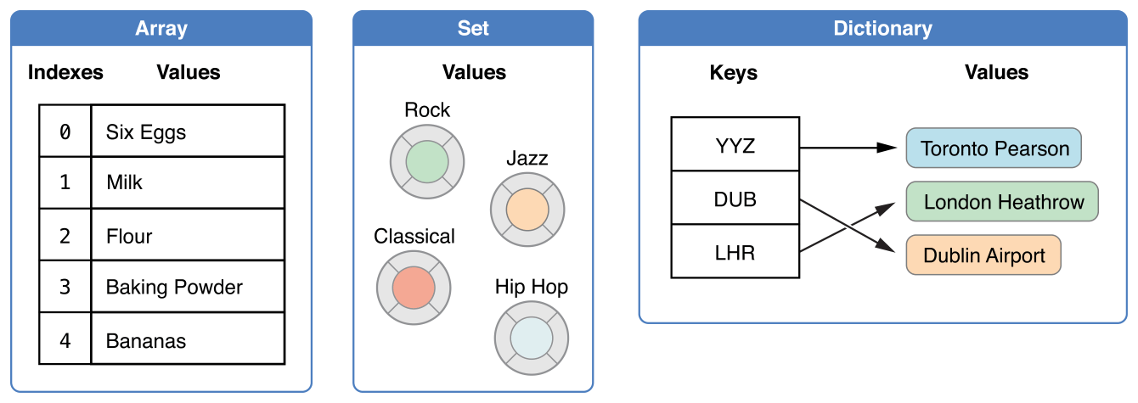
COLLECTION TYPES

Slide 17
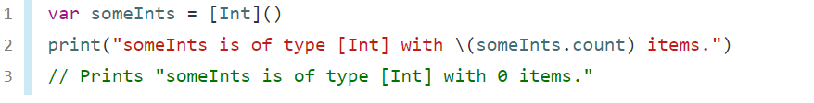
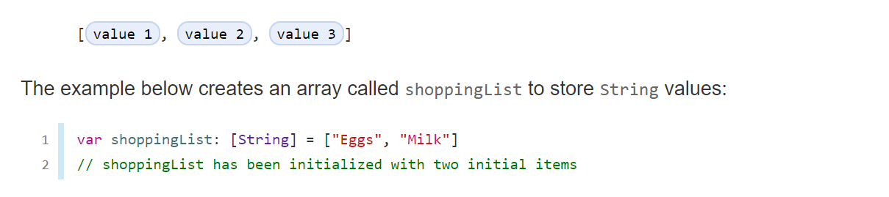
ARRAYS

Slide 18
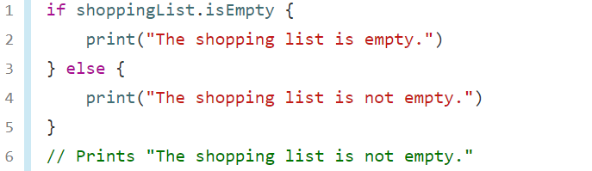
ARRAYS
for item in shoppingList {
print(item)
}
let mapleSyrup = shoppingList.remove(at: 0)

Slide 19
SET
var letters = Set<Character>()
print("letters is of type Set<Character> with \(letters.count) items.")
// Prints "letters is of type Set<Character> with 0 items."
var favoriteGenres: Set<String> = ["Rock", "Classical", "Hip hop"]
// favoriteGenres has been initialized with three initial items
favoriteGenres.insert("Jazz")

Slide 20
SET

Slide 21
DICITIONARY
var namesOfIntegers = [Int: String]()
// namesOfIntegers is an empty [Int: String] dictionary
namesOfIntegers[16] = "sixteen"
// namesOfIntegers now contains 1 key-value pair
namesOfIntegers = [:]
// namesOfIntegers is once again an empty dictionary of type [Int: String]

Slide 22
DICITIONARY
var airports = ["YYZ": "Toronto Pearson", "DUB": "Dublin"]
var airports: [String: String] = ["YYZ": "Toronto Pearson", "DUB": "Dublin"]
if airports.isEmpty {
print("The airports dictionary is empty.")
} else {
print("The airports dictionary is not empty.")
}
// Prints "The airports dictionary is not empty."
if let oldValue = airports.updateValue("Dublin Airport", forKey: "DUB") {
print("The old value for DUB was \(oldValue).")
}

Slide 23
For in Loops
let names = ["Anna", "Alex", "Brian", "Jack"]
for name in names {
print("Hello, \(name)!")
}
// Hello, Anna!
// Hello, Alex!
// Hello, Brian!
// Hello, Jack!

Slide 24
While
while condition {
statements
}

Slide 25
While
var square = 0
var diceRoll = 0
while square < finalSquare {
// roll the dice
diceRoll += 1
if diceRoll == 7 { diceRoll = 1 }
// move by the rolled amount
square += diceRoll
if square < board.count {
// if we're still on the board, move up or down for a snake or a ladder
square += board[square]
}
}
print("Game over!")

Slide 26
Switch
let someCharacter: Character = "z"
switch someCharacter {
case "a":
print("The first letter of the alphabet")
case "z":
print("The last letter of the alphabet")
default:
print("Some other character")
}
// Prints "The last letter of the alphabet"

Slide 27
Hands On!

Slide 28
Functions
func greet(person: String) -> String {
let greeting = "Hello, " + person + "!"
return greeting
}
print(greet(person: "Anna"))
// Prints "Hello, Anna!"
print(greet(person: "Brian"))
// Prints "Hello, Brian!"
func greet(person: String) {
print("Hello, \(person)!")
}
greet(person: "Dave")
// Prints "Hello, Dave!

Slide 29
Hands On!

Slide 30
Enumerations Syntax
enum CompassPoint {
case north
case south
case east
case west
}

Slide 31
Enumerations
directionToHead = .south
switch directionToHead {
case .north:
print("Lots of planets have a north")
case .south:
print("Watch out for penguins")
case .east:
print("Where the sun rises")
case .west:
print("Where the skies are blue")
}

Slide 32


Enumerations

Slide 33
Enumerations
enum Barcode {
case upc(Int, Int, Int, Int)
case qrCode(String)
}
var productBarcode = Barcode.upc(8, 85909, 51226, 3)
productBarcode = .qrCode("ABCDEFGHIJKLMNOP")
switch productBarcode {
case .upc(let numberSystem, let manufacturer, let product, let check):
print("UPC: \(numberSystem), \(manufacturer), \(product), \(check).")
case .qrCode(let productCode):
print("QR code: \(productCode).")
}

Slide 34


A Picture Is Worth A Thousand Words
Itself is what the end-user derives value from also can refer is what the end-user derives value from also can refer to the information provided through the medium.

Slide 35
Structs
struct SomeStructure {
// structure definition goes here
}
Define properties to store values
Define methods to provide functionality
Define subscripts to provide access to their values using subscript syntax
Define initializers to set up their initial state
Be extended to expand their functionality beyond a default implementation
Conform to protocols to provide standard functionality of a certain kind
Value Type

Slide 36
Classes
class SomeStructure {
// structure definition goes here
}
Define properties to store values
Define methods to provide functionality
Define subscripts to provide access to their values using subscript syntax
Define initializers to set up their initial state
Be extended to expand their functionality beyond a default implementation
Conform to protocols to provide standard functionality of a certain kind
Reference Type

Slide 37
Classes
Classes have additional capabilities that structures don’t have:
Inheritance enables one class to inherit the characteristics of another.
Type casting enables you to check and interpret the type of a class instance at runtime.
Deinitializers enable an instance of a class to free up any resources it has assigned.
Reference counting allows more than one reference to a class instance.

Slide 38
A Picture Is Worth A Thousand Words
Itself is what the end-user derives value from also can refer is what the end-user derives value from also can refer to the information provided through the medium.

Slide 39
Structs vs Classes
struct Resolution {
var width = 0
var height = 0
}
class VideoMode {
var resolution = Resolution()
var interlaced = false
var frameRate = 0.0
var name: String?
}
let someResolution = Resolution()
let someVideoMode = VideoMode()

Slide 40
Structs vs Classes
let someResolution = Resolution()
let someVideoMode = VideoMode()
someVideoMode.resolution.width = 1280
print("The width of someVideoMode is now \(someVideoMode.resolution.width)")
let vga = Resolution(width: 640, height: 480)

Slide 41
Structs vs Classes
let hd = Resolution(width: 1920, height: 1080)
var cinema = hd
cinema.width = 2048
print("cinema is now \(cinema.width) pixels wide")
// Prints "cinema is now 2048 pixels wide"
print("hd is still \(hd.width) pixels wide")
// Prints "hd is still 1920 pixels wide"

Slide 42
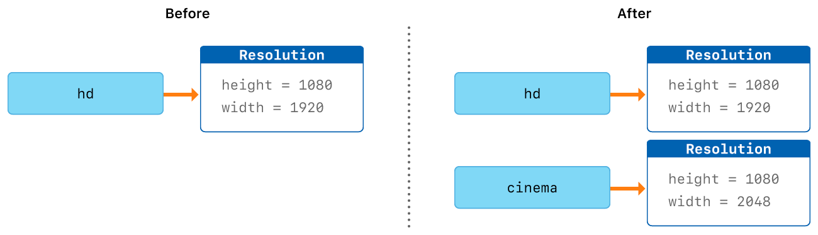
Structs vs Classes

Slide 43
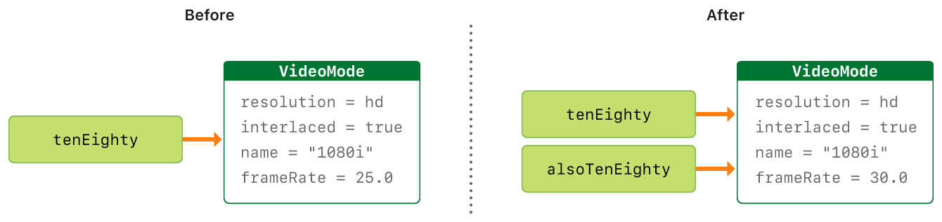
Structs vs Classes
let tenEighty = VideoMode()
tenEighty.resolution = hd
tenEighty.interlaced = true
tenEighty.name = "1080i"
tenEighty.frameRate = 25.0
let alsoTenEighty = tenEighty
alsoTenEighty.frameRate = 30.0

Slide 44

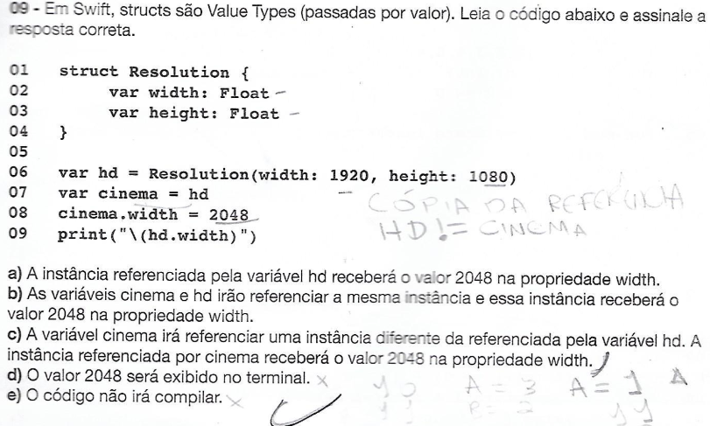
Structs vs Classes
let hd = Resolution(width: 1920, height: 1080)
var cinema = hd
cinema.width = 2048
print("cinema is now \(cinema.width) pixels wide")
// Prints "cinema is now 2048 pixels wide"
print("hd is still \(hd.width) pixels wide")
// Prints "hd is still 1920 pixels wide"

Slide 45
Thanks!
Any questions?
You can find me at: @ViniciusDeep in gitHub

